Slide 1
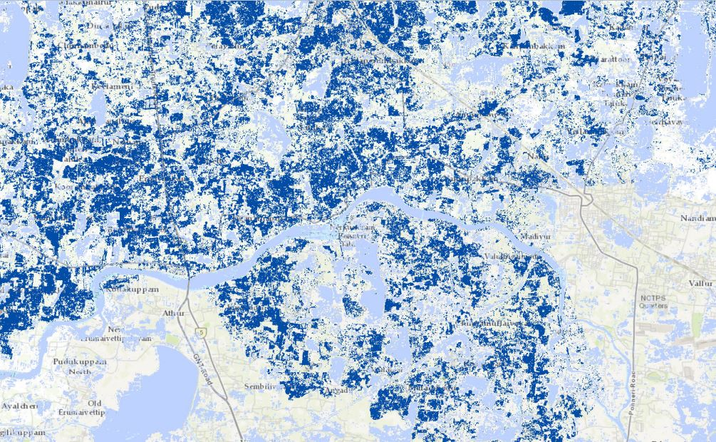
Chennai Floods
Case Study-3
A Man-made Natural Disaster
Source: IWMI
Notes:
Additional Reading Material:
Page 27 in the “environmental reader” textbook.
https://www.downtoearth.org.in/news/natural-disasters/why-chennai-floods-are-a-man-made-disaster-51980
https://www.downtoearth.org.in/coverage/natural-disasters/reeling-under-floods-55089
http://www.dmcii.com/?p=11230
https://reliefweb.int/map/india/second-wave-catastrophic-flooding-chennai-tamil-nadu-india-09-december-2015
https://india.mongabay.com/2019/04/commentary-looking-beyond-the-chennai-city-at-the-chennai-watershed/
https://indianexpress.com/photos/india-news/chennai-water-crisis-chennai-weather-rains-imd-5792701/
Prepared By: Shaurya Rahul Narlanka

Slide 2
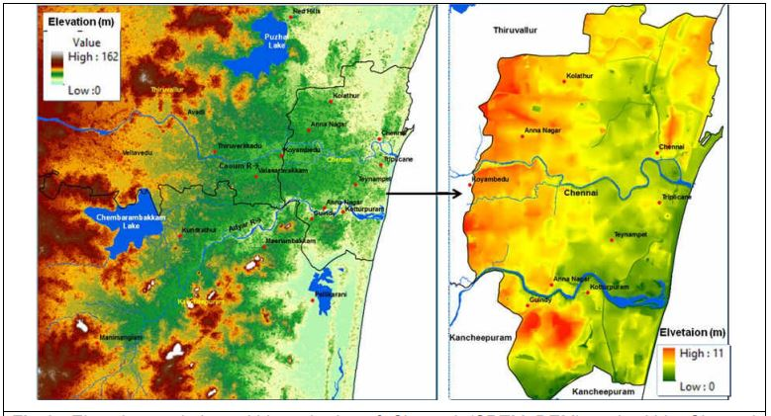
Elevation within suburbs of Chennai and within the Chennai District
Narasimhan et. al (2015)
Notes:
Chennai, based on its geography and geology, has historically been characterized as a flood plain where a set of interconnected wetlands and natural water channels store and drain the surcharge during its two monsoonal seasons (the south-west monsoons and the north-east monsoons) from what is essentially a flat land (as you can see from the elevation in the above provided maps. For reference, Manipal is 73m over mean sea level (MSL)). It is also dependent on many of these wetlands for protection against cyclones, to which the entire Indian Eastern coastline is particularly vulnerable to. These complex network of wetlands are therefore extremely important for they city’s resiliency and it is crucial that any urban planning of the city is sensitive to them.
Citation:
Narasimhan, B & Murty Bhallamud, S & Mondal, Arpita & Ghosh, Subimal & Mujumdar, P. (2016). Chennai Floods 2015 : A Rapid Assessment.

Slide 3
Chennai, based on its geography and geology, has historically been characterized as a flood plain where a set of interconnected wetlands and natural water channels store and drain the surcharge during its two monsoonal seasons (the south-west monsoons and the north-east monsoons) from what is essentially a flat land (as you can see from the elevation in the above provided maps. For reference, Manipal is 73m over mean sea level (MSL)). It is also dependent on many of these wetlands for protection against cyclones, to which the entire Indian Eastern coastline is particularly vulnerable to. These complex network of wetlands are therefore extremely important for the city’s resiliency and it is crucial that any urban planning of the city is sensitive to them.

Slide 4
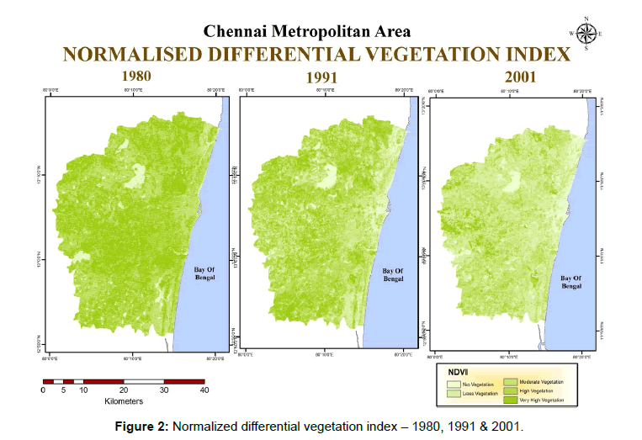
Narmada K, Bhaskaran G (2017)
Notes:
Unfortunately, since independence and more recently in 2000s, due to the IT boom, the city has seen an unsustainable and unscientific urbanization which in numerous cases has led to loss of green cover and encroachment of waterbodies. The entire urban plan of the fast expanding city was disconnected from the hydrology of the area and this led to a sharp decrease in the effectiveness of Chennai’s wetlands to perform their water regulatory functions.
Citations:
Narmada K, Bhaskaran G (2017) Multi-Temporal Analysis and Quantification of the Carbon Stocks in the Urban Forests of Chennai Metropolitan Area Using Geoinformatics Techniques to Identify Their Role in Climate Change Mitigation. Geoinfor Geostat: An Overview 5:4. doi: 10.4172/2327-4581.1000172

Slide 5
Unfortunately, since independence and more recently in 2000s, due to the IT boom, the city has seen an unsustainable and unscientific urbanization which in numerous cases has led to loss of green cover and encroachment of waterbodies. The entire urban plan of the fast expanding city was disconnected from the hydrology of the area and this led to a sharp decrease in the effectiveness of Chennai’s wetlands to perform their water regulatory functions.

Slide 6
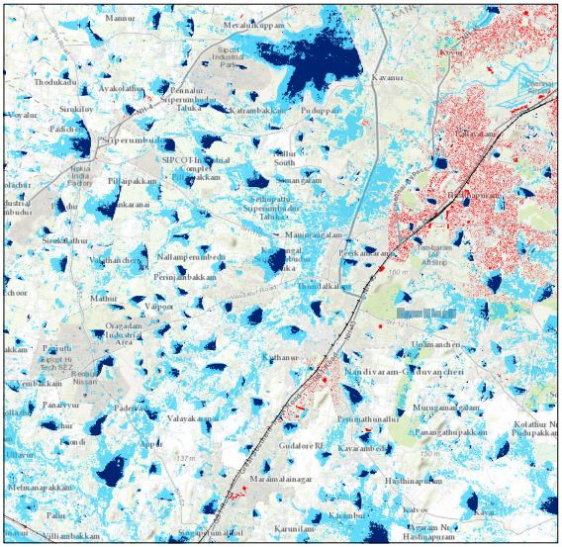
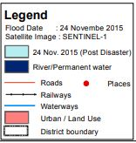
2015 CHENNAI FLOODING
Source: IWMI
Notes:
As a result, during the months of November-December in 2015 Chennai received record setting rainfall (highest recorded) due to an exceptional warming of the eastern equatorial pacific ocean (now dubbed as the 2014-16 El Nino event. More information here: https://en.wikipedia.org/wiki/2014–16_El_Niño_event). Since, the lakes which would have otherwise help absorb the excess flow and their network was encroached on, and the urbanization stopped the flow of water where it should not have stopped, the effect of the heavy rains was amplified; multiplying the scale of the disaster. The above maps show the scale of the flooding. The dark blue zones are natural water bodies, light blue zones are the flooded areas and the red areas are urban areas.

Slide 7
As a result, during the months of November-December in 2015 Chennai received record setting rainfall (highest recorded) due to an exceptional warming of the eastern equatorial pacific ocean. Since, the lakes which would have otherwise help absorb the excess flow and their network was encroached on, and the urbanization stopped the flow of water where it should not have stopped, the effect of the heavy rains was amplified; multiplying the scale of the disaster. The above maps show the scale of the flooding. The dark blue zones are natural water bodies, light blue zones are the flooded areas and the red areas are urban areas.

Slide 8
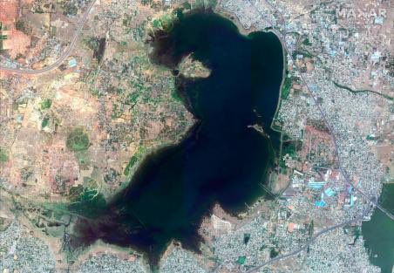
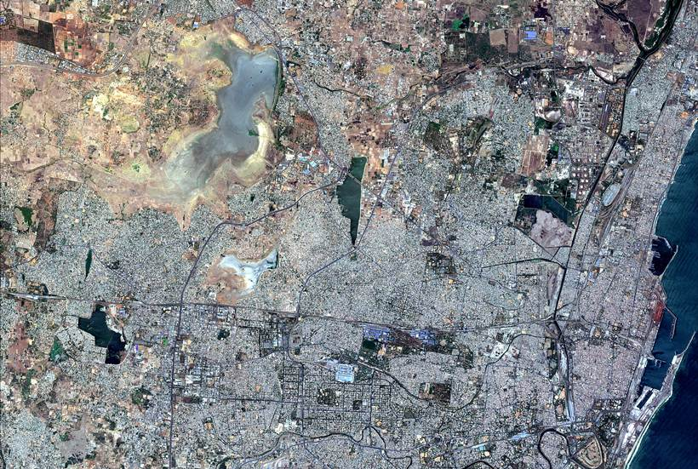
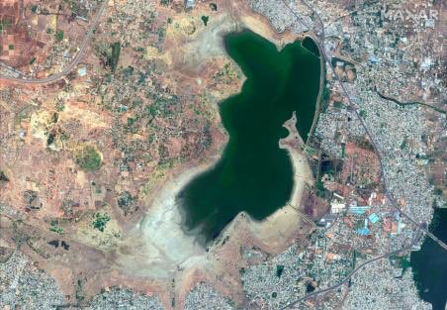
June 15, 2018
CHENNAI WATER SHORTAGE: PUZHAL RESERVOIR
June 15, 2019
April 6, 2019
Source: Indian Express
Notes:
This encroachment has caused another serious issue. Water shortages. Since the wetlands are not connected or are encroached on, they don’t receive sufficient water to ensure that they have water during the summer months. As a consequence, the city has had to rely on ground water in the summer for its supply which has also started to dry (again, due to poor surface water circulation and storage). Furthermore, since Chennai is on the coast, the drained aquifers are intruded by sea water, increasing the salinity of the land above them (and of the aquifers themselves, of course), destroying the agriculture of the region. This has led to increased burden on the already in-debt farmers leading to a sharp rise in farmer suicides (read more about it here: https://en.wikipedia.org/wiki/2016–17_Drought_in_Tamil_Nadu). In the above images, you can see the sharp decreased in the water level in the Puzhal Reservoir, the largest reservoir in Chennai over the summer months between 2018-2019 as a consequence of the bad urban planning, over extraction of ground water and a drought.

Slide 9
This encroachment has caused another serious issue. Water shortages. Since the wetlands are not connected or are encroached on, they don’t receive sufficient water to ensure that they have water during the summer months. As a consequence, the city has had to rely on ground water in the summer for its supply which has also started to dry (again, due to poor surface water circulation and storage). Furthermore, since Chennai is on the coast, the drained aquifers are intruded by sea water, increasing the salinity of the land above them (and of the aquifers themselves, of course), destroying the agriculture of the region. This has led to increased burden on the already in-debt farmers leading to a sharp rise in farmer suicides. In the above images, you can see the sharp decreased in the water level in the Puzhal Reservoir, the largest reservoir in Chennai over the summer months between 2018-2019 as a consequence of the bad urban planning, over extraction of ground water and a drought.

